Slide 1
EMTH403
Mathematical Foundation for Computer Science

Slide 2
Lecture Outcomes
Understand what are Planar Graphs
Understand how K_{3,3} is a non-planar Graph.

Slide 3
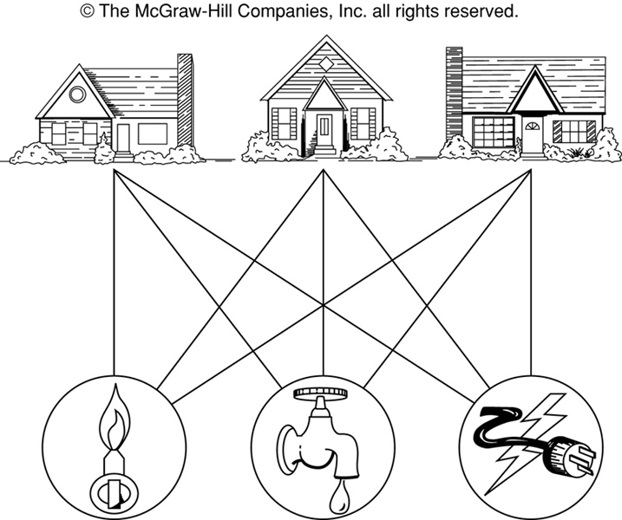
Planar Graphs
The House-and-Utilities Problem
Is it possible to join the three houses to the three utilities in such a way that none of the connections cross?

Slide 4
Planar Graphs
Phrased another way, this question is equivalent to: Given the complete bipartite graph K_{3,3}, can K_{3,3} be drawn in the plane so that no two of its edges cross?
K_{3,3}

Slide 5
Planar Graphs
A graph is called planar if it can be drawn in the plane without any edges crossing.
A crossing of edges is the intersection of the lines or arcs representing them at a point other than their common endpoint.
Such a drawing is called a planar representation of the graph.

Slide 6
Planar Graphs
A graph may be planar even if it is usually drawn with crossings, since it may be possible to draw it in another way without crossings.

Slide 7
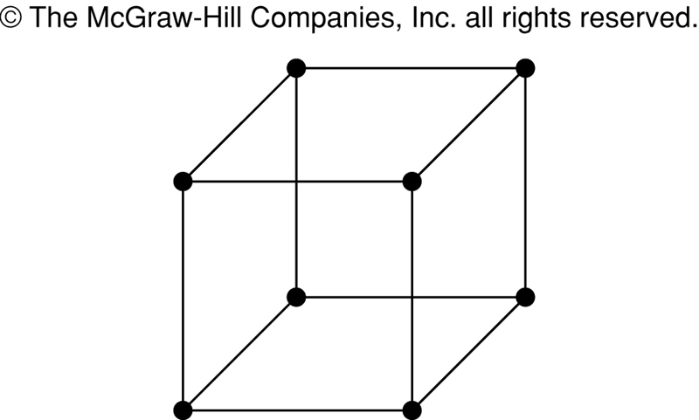
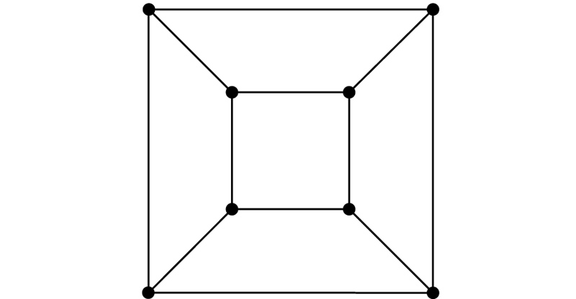
Planar Graphs
A graph may be planar even if it represents a 3-dimensional object.

Slide 8
Planar Graphs
Definition:
  A planar graph G that is drawn in the plane so that no two edges intersect (that is, G is embedded in the plane) is called a plane graph.
(a) planar,
not a plane graph
(c) another
plane graph
(b) a plane graph

Slide 9
Planar Graphs
Note. A given planar graph can give rise to several different plane graph.
G₁
R₃: exterior
R₁
R₂
G₁ has 3 regions.

Slide 10
Planar Graphs
Definition:
Let G be a plane graph. The connected pieces of the plane that remain when the vertices and edges of G are removed are called the regions of G.
G₁
R₃: exterior
R₁
R₂
G₁ has 3 regions.

Slide 11
Planar Graphs
We can prove that a particular graph is planar by showing how it can be drawn without any crossings.
However, not all graphs are planar.
It may be difficult to show that a graph is nonplanar. We would have to show that there is no way to draw the graph without any edges crossing.

Slide 12
Regions
Euler showed that all planar representations of a graph split the plane into the same number of regions, including an unbounded region.
R₄ R₃ R₂
R₁

Slide 13
Planar Graphs
In any planar representation of K_{3,3}, vertex v₁ must be connected to both v₄ and v₅, and v₂ also must be connected to both v₄ and v₅.
v₁ v₂ v₃
v₄ v₅ v₆

Slide 14
Regions
Euler showed that all planar representations of a graph split the plane into the same number of regions, including an unbounded region.
R₄ R₃ R₂
R₁

Slide 15
Regions
In any planar representation of K_{3,3}, vertex v₁ must be connected to both v₄ and v₅, and v₂ also must be connected to both v₄ and v₅.
v₁ v₂ v₃
v₄ v₅ v₆

Slide 16
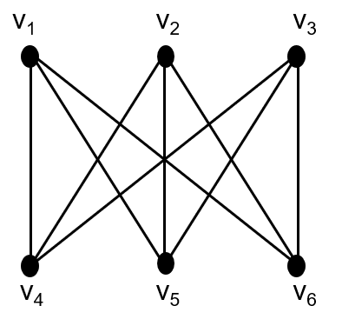
Regions
The four edges {v₁, v₄}, {v₄, v₂}, {v₂, v₅}, {v₅, v₁} form a closed curve that splits the plane into two regions, R₁ and R₂.
v₁ v₅
R₂ R₁
v₄ v₂

Slide 17
Regions
Next, we note that v₃ must be in either R₁ or R₂.
Assume v₃ is in R₂. Then the edges {v₃, v₄} and {v₄, v₅} separate R₂ into two subregions, R₂₁ and R₂₂.
v₁ v₅ v₁ v₅
R₂₁
R₂ R₁ → v₃
R₂₂
v₄ v₂ v₄ v₂

Slide 18
Regions
Now there is no way to place vertex v₆ without forcing a crossing:
  If v₆ is in R₁ then {v₆, v₃} must cross an edge
  If v₆ is in R₂₁ then {v₆, v₂} must cross an edge
  If v₆ is in R₂₂ then {v₆, v₁} must cross an edge
v₁ v₅
R₂₁ v₃ R₁
R₂₂
v₄ v₂

Slide 19
Regions
Alternatively, assume v₃ is in R₁. Then the edges {v₃, v₄} and {v₄, v₅} separate R₁ into two subregions, R₁₁ and R₁₂.
v₁ v₅
R₁₁
R₂ R₁₂ v₃
v₄ v₂

Slide 20
Regions
Now there is no way to place vertex v₆ without forcing a crossing:
  If v₆ is in R₂ then {v₆, v₃} must cross an edge
  If v₆ is in R₁₁ then {v₆, v₂} must cross an edge
  If v₆ is in R₁₂ then {v₆, v₁} must cross an edge
v₁ v₅
R₁₁
R₂ R₁₂ v₃
v₄ v₂

Slide 21
Planar Graphs
Consequently, the graph K_{3,3} must be nonplanar.
K_{3,3}

Slide 22
Theorem 1 (Kuratowski, 1930)
A graph is planar if and only if it does not contain a subgraph that is a K₅ or K_{3,3} configuration.

